Slide 1
Professional Discipline
Our approach to managing risk and responding to concerns in professional disciplinary work
2025

Slide 2
Weightmans – Professional Discipline
Professional Discipline – a proven track record
When it comes to advising insurers and their customers on ‘all things’ insurance, you’re in safe hands. We are a leading provider of legal insurance solutions and have been advising in this space for many years. As a leading UK professional disciplinary practice, we bring together experts in not just insurance, but specialists in all disciplines to cover all the bases for your legal needs.
We know from our extensive experience across all sectors that a Professional Disciplinary investigation is likely to be the most stressful event in an Insured’s career, where an adverse outcome could be career and/or business ending.
Where Insured’s are companies, we have also seen how when an individual in that company is being investigated, this can cause a very significant distraction from the business’ primary practice, resulting in increased risk exposure generally.
For Insurers, whilst we know that professional disciplinary investigations can lead to significant costs, we also know that where Insureds receive the right expert support early from an industry-leading team then:
Those costs can be significantly mitigated by managing the scope of the investigations; and
As awareness of regulatory proceedings increases, and they are frequently being used as ‘stalking horses’ to ‘test the water’ in advance of litigation (which can then be even more expensive), the right approach can result in a net benefit even if disciplinary proceedings subsequently proceed.
Having worked with many Insureds, Insurers and Regulated Professionals Defence Organisations on professional disciplinary matters, we have developed a “crisis is always better avoided than resolved” approach. This advances the objectives of Insurers and Insured alike by reducing the impact and duration of an investigation on the professional, whilst minimising the Insurers costs exposure to legal spend and subsequent claims.
We also pride ourselves on the continuity of service which runs from crisis containment, through the regulatory process and resolution, and then all the way to subsequent business resilience improvement to long term improvement of the quality of the risks you underwrite.
We would be delighted to talk to you further about how we can work to improve your professional disciplinary risk moving forwards.
Weightmans at a glance
Leading professional disciplinary practice – over 100 years’ market experience with specialist lawyers
Proven track record advising leading market players – such as insurers, medical defence organisations, local authorities and education trusts
Wider full-service offering
National firm with international reach – via Insurance Law Global and extensive informal network
Full-service offering across 9 UK offices: Birmingham, Cardiff, Glasgow, Leeds, Leicester, Liverpool, London, Manchester, Newcastle
86 insurance partners supported by over 380 lawyers
Over 1500 people nationally
Advice underpinned by sector knowledge and understanding.

Slide 3
How we can help you
Weightmans – Professional Discipline
Our expertise can assist you at all stages of the professional disciplinary lifecycle.
There are five stages of the professional disciplinary lifecycle:
Prevention
Crisis containment
Investigation
Disciplinary hearings
Resilience strengthening.
Prevention
Crisis containment
Investigation
Disciplinary hearings
Resilience strengthening

Slide 4
Weightmans – Professional Discipline
How we can help you
Professional disciplinary lifecycle continued…
 | What we do | How this helps Insurers
Prevention | Risk management seminars, publications and toolkits for Insureds Insights and MI from our wider regulatory casework Engagement with regulators in stakeholder processes. | Reduces likelihood of regulatory issues arising, increases resilience and promotes the value of the Insurer’s product Identifying trends in referrals, case types and risk areas Insurer voices are “heard” by the regulator in user-group discussions and policy development.
Crisis containment | Actively consider the implications of an event in the wider regulatory context Provide early advice on mitigation and remediation Advice on professional responsibilities including the Duty of Candour. | Prevents tactical mis-steps which may trigger further proceedings in another forum, with additional cost for Insurers and negative impact on the Insured Maximises the prospect of early closure Reduces likelihood of complaint and subsequent regulatory action.
Investigation | Pragmatic advice focussed on achieving agreed objectives; we don’t “take every point” Advice on early admissions where appropriate Proactive engagement with the regulator to agree facts and narrow the issues A perspective-driven approach. | Maximises the prospect of early closure of investigations, limiting the cases that proceed to hearings to those where there is a key factual dispute, or the allegations are of a most serious nature Reduces length of the investigation, increases prospect of closure and limits Insurer costs Reduces unnecessary cost by reducing hearing time and litigation of unnecessary issues Ensures broad strategic objectives are not sacrificed to achieve less important short-term advantages.
Disciplinary hearings | Expert knowledge of the Tribunals and their individual members factors into case presentation In-house advocacy where appropriate Targeted use of Counsel. | Ensures points are conveyed in the most appropriate manner, increasing prospects of a positive outcome Ensures Insurer resources are committed where they will have most impact.
Resilience strengthening | Cases "mined” for anonymous MI, feeding back into prevention strategies Use of our national full-service offering to remove risks in the future, from corporate restructuring, contract suite review and staff training, negotiated bespoke solutions with regulators. | Future risk prevention is shared more widely than with the Insured involved.

Slide 5
Our specific triage products
Weightmans – Professional Discipline
As noted above, we firmly believe that a:
“crisis is always better avoided than resolved”.
To that end, we can offer Insurers bespoke services whereby, for a fixed fee – offer your Insureds:
A 1hr phone conversation to discuss the complaint and give broad guidance on what to do/not do;
Assistance with drafting the primary acknowledgement to the regulator/complainant; and
Initial email guidance for preparation/next steps.
For a relatively small fee, we have found that we can drastically reduce the number of complaints pursued by regulators, and even when complaints are pursued, we have found that our early involvement can drastically reduce the investigations pursued.
A number of our clients have written us into their policies, and this may be something you also wish to do with your relevant policies. It could be a condition of cover that, if and when complaints are received, your Insureds need to make use of our services. Too often – no doubt out of best intentions – Insured’s initial responses set matters off on the ‘wrong foot’ and then bind our ability to manage matters in due course.

Slide 6
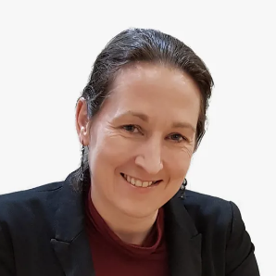
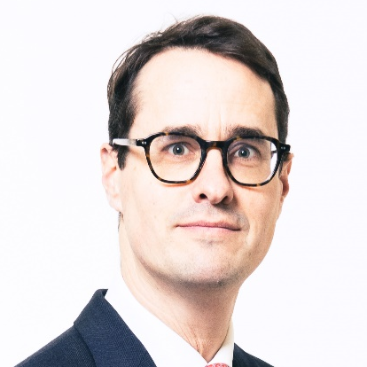
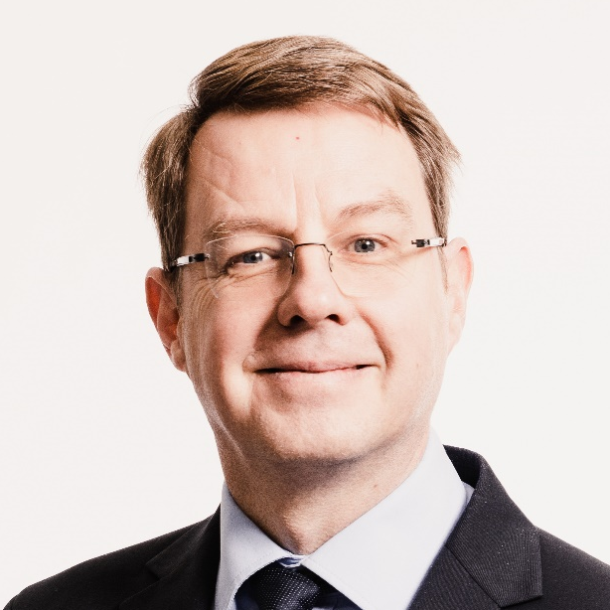
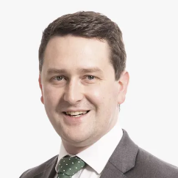
Get in touch
Weightmans – Professional Discipline
Susanna Heley
Head of Legal and Financial Services Disciplinary
Mob: 07773 111 167
susanna.heley@weightmans.com
We would be delighted to discuss this with yourselves and/or your key placing brokers to see if there are opportunities where we can work further together.
We can also provide more detailed information on our various sector expertise and experience if there is a particular area which is most important to you.
We look forward to working with you moving forwards.
Weightmans
February 2025
Simon Gomersall
Head of Healthcare Disciplinary
Mob: 07773 111 173
simon.gomersall@weightmans.com
Alistair Hewitt
Head of Emerging Professions Disciplinary
Mob: 07825 363 528
alistair.hewitt@weightmans.com
Tom Thurlow
Head of Emerging Built Environment Disciplinary
Mob: 07791 702 213
tom.thurlow@weightmans.com

Slide 7
Weightmans – Professional Discipline
Working with Weightmans
Testimonials
“Weightmans LLP is 'without a doubt the leader in this field’.”
Legal 500 2024
“The go-to firm for healthcare professional discipline defence. Without a doubt the leader in this field, with vast experience and an excellent team of committed and knowledgeable lawyers.”
Legal 500 2024
“Weightmans has an excellent selection of partners at the top of their game."
Chambers & Partners 2025
“Recommended to any solicitor who has a professional conduct issue with the SRA.”
Legal 500 2024
"The team is excellent, its services and responses are outstanding."
Chambers & Partners 2024
“Weightmans is a very strong firm with a good selection of meticulous and talented lawyers who are able to handle the most complex of matters and provide very good client care."
Chambers & Partners 2024
"It's one of the Rolls Royce firms and is very impressive."
Chambers & Partners 2025
"A pre-eminent firm in professional discipline. It has huge depth of experience and a huge talent of senior and juniors. Everyone there is good."
Chambers & Partners 2024

Slide 8
Weightmans – Professional Discipline

